Slide 1

ILA/TESOL Collaborations: Exploring Ways to Enhance Pre-Service Teacher Education for Teaching Multilingual EL Students
OCTEO
October 9, 2025
Steven Wisnor & Theresa Thanos

Slide 2
Session Goals
Introduce the presenters’ emerging approach for fostering greater collaboration between programs and candidates
Reflect on their own approaches to preparing pre-service teachers (PSTs) for teaching English learners (ELs)
Share successes and challenges we encounter in this work

Slide 3
Session Agenda
Introducing presenters and their project
Sharing motivations, approaches, and findings so far
Conveying a sense of PSTs’ engagement
Discussing our (i.e., all session participants’) approaches and findings

Slide 4
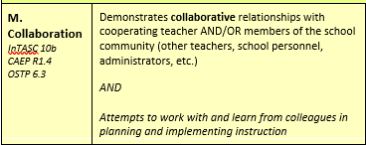
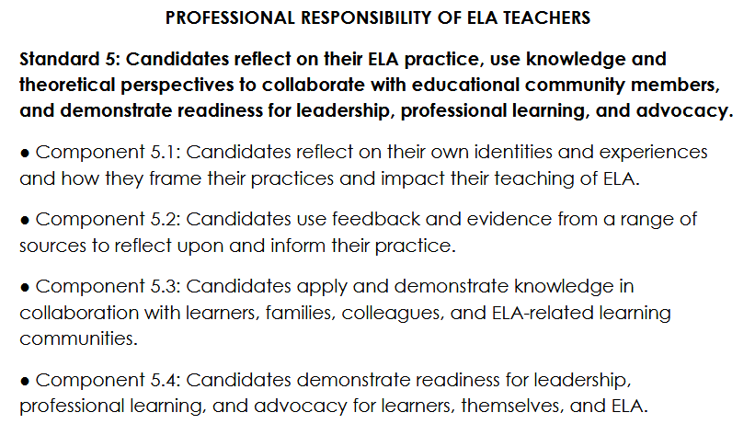
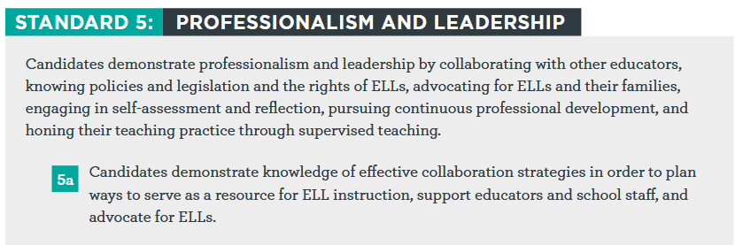
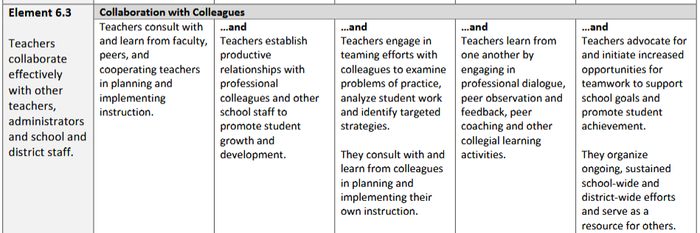
Foundations
Pre-CPAST Assessment
NCTE Standards (2021)
Professional Development
Professional Collaboration
Ped. Content Knowledge
TESOL Standards (2018)
OSTP Continuum of Teacher Dev. (2011)

Slide 5
Foundations (2)
Giles, A., Yazin, B. (2023)
Constructing teacher identity in teacher collaboration: What does it mean to be a teacher of culturally and linguistically diverse learners?.
Honigsfeld, A., Dove, M. (2016)
Collaborative practices to support implementation of the Common Core State Standards with K-5 English learners.
Pre-Service ILA & TESOL Teacher Collaboration
Derewianka, B., Jones, P. (2023)
Teaching language in context (Third edition)
Moll, L. C., Amanti, C., Neff, D., & Gonzalez, N. (1992). Funds of Knowledge for Teaching: Using a Qualitative Approach to Connect Homes and Classrooms. Theory Into Practice.

Slide 6
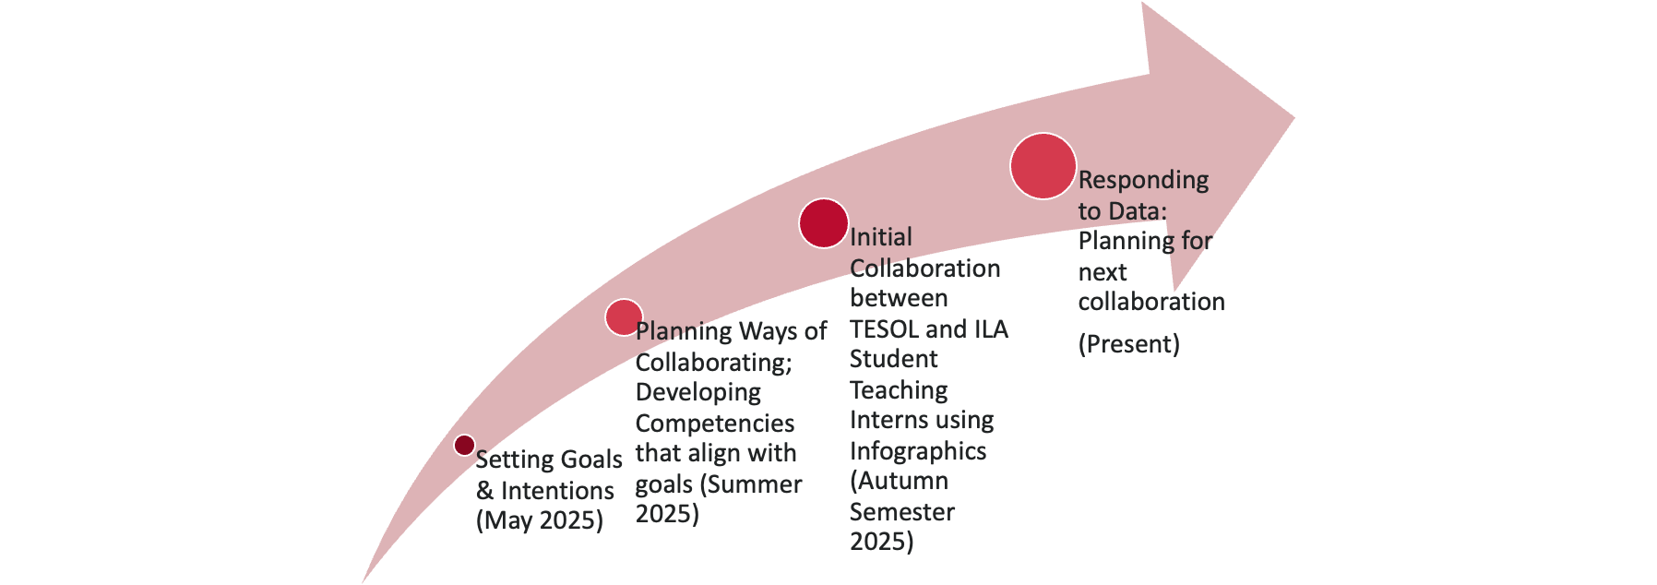
Our Collaboration
Engaging in collaborative dialogue to best serve and plan for our PSTs since May 2025
Modeling practices for collaboration: Sharing, Listening, Questioning, Analyzing
Engaging in dialogic argumentation (Bloome, Newell, Hirvela, 2019) to broaden contextualized rationality for both counterparts – seeking knowledge to become an insider in the other's perspective

Slide 7
Goals & Intentions for our Pre-Service Teachers
ILA and EL student teachers will collaborate to have the base knowledge to “become an insider” and understand the perspectives and experiences of the other area of expertise.​
ILA and ELL student teachers will embrace/practice collaborative vulnerability to advocate for their students through constant learning. This competency positions them to gain confidence to ask questions and seek out resources and people in their own teaching… stressing what it means to be a “well-meaning/intentional ILA or EL teacher” who wants the best possible outcomes for all their students.

Slide 8

Competencies From Survey
Defining "Language Arts class" or "EL class"
Knowledge of language arts classes or EL students/numbers at placement
Familiarity with language arts teachers/Standards or EL teachers/Standards
Frequency of teaching language arts content or EL students
Comfort and frequency collaborating with language arts or EL teachers
Comfort with teaching literature, language, and culture
Comfort with students using multiple languages in class

Slide 9
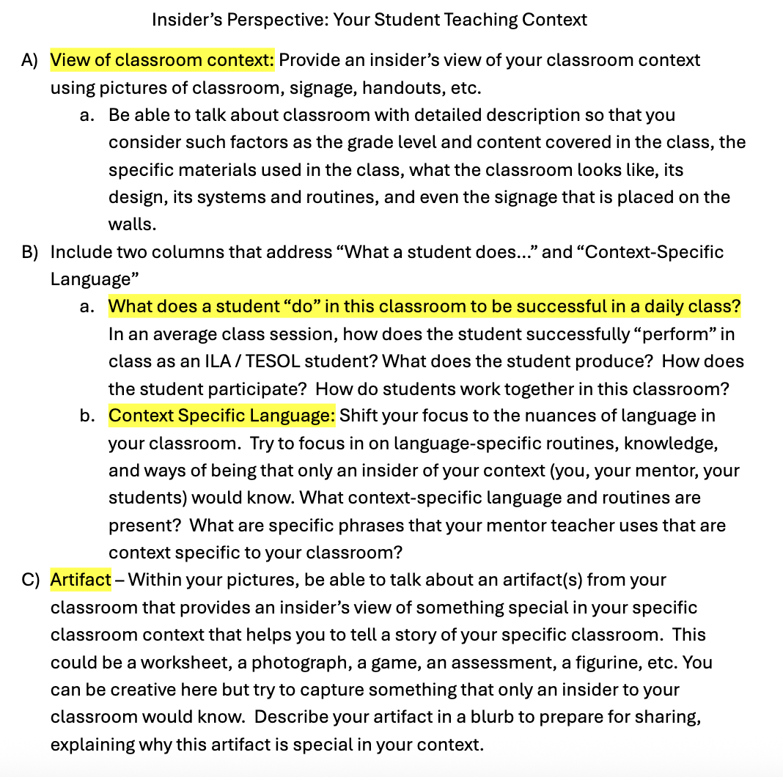
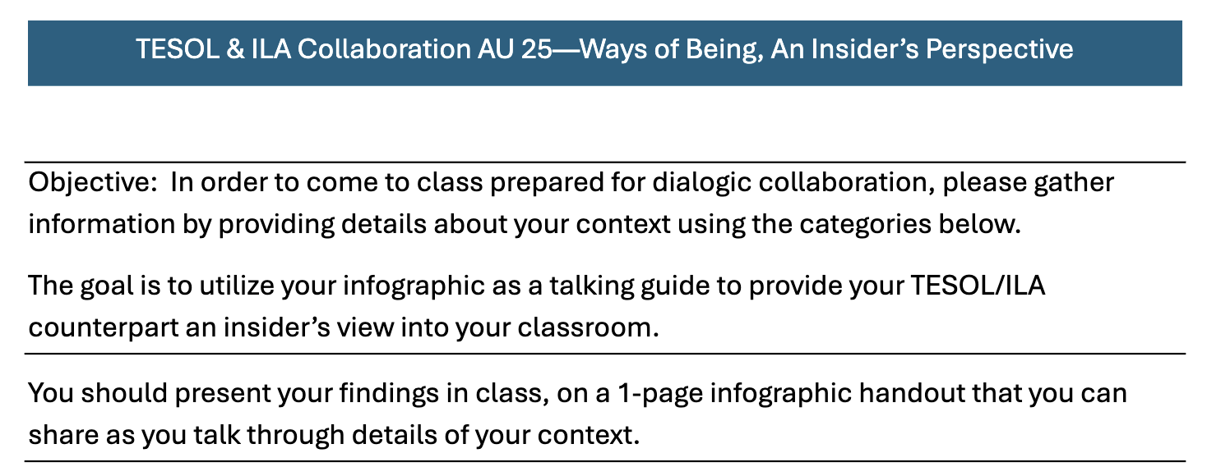
Agenda for Initial Collaboration
Groupings: 5-6 ILA Student to 1 TESOL Student Teacher
Directions for Sharing Infographic
Padlet: Space to Record Takeaways

Slide 10
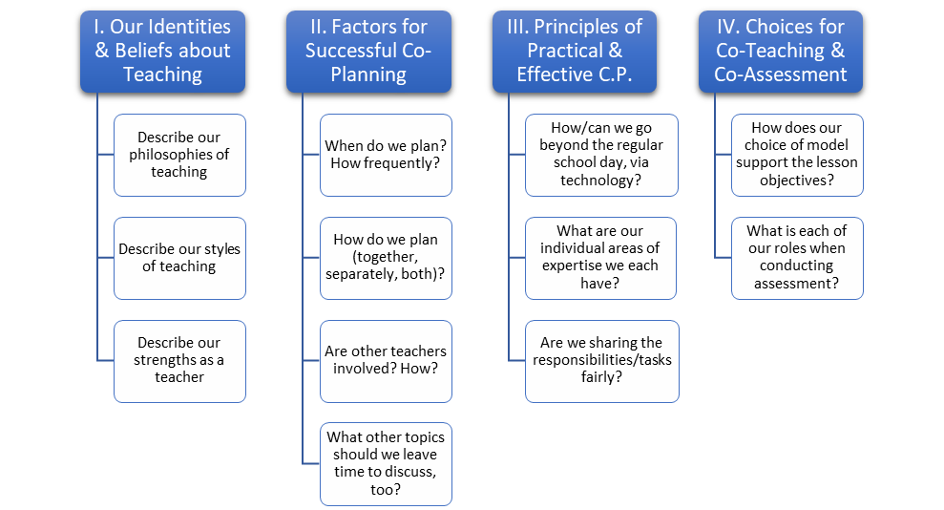
Questions for initial co-planning conversations
SLIDE USED with students prior to their sharing in small groups to promote professional vulnerability and inquiry through collaboration.
Conversations must start with and focus on a mutual understanding of the learning objectives (p. 245).
Pratt, S.M., et al. (2017). Co-planning in co-teaching: A practical solution. Intervention in School and Clinic, 52(4), 243-249.

Slide 11
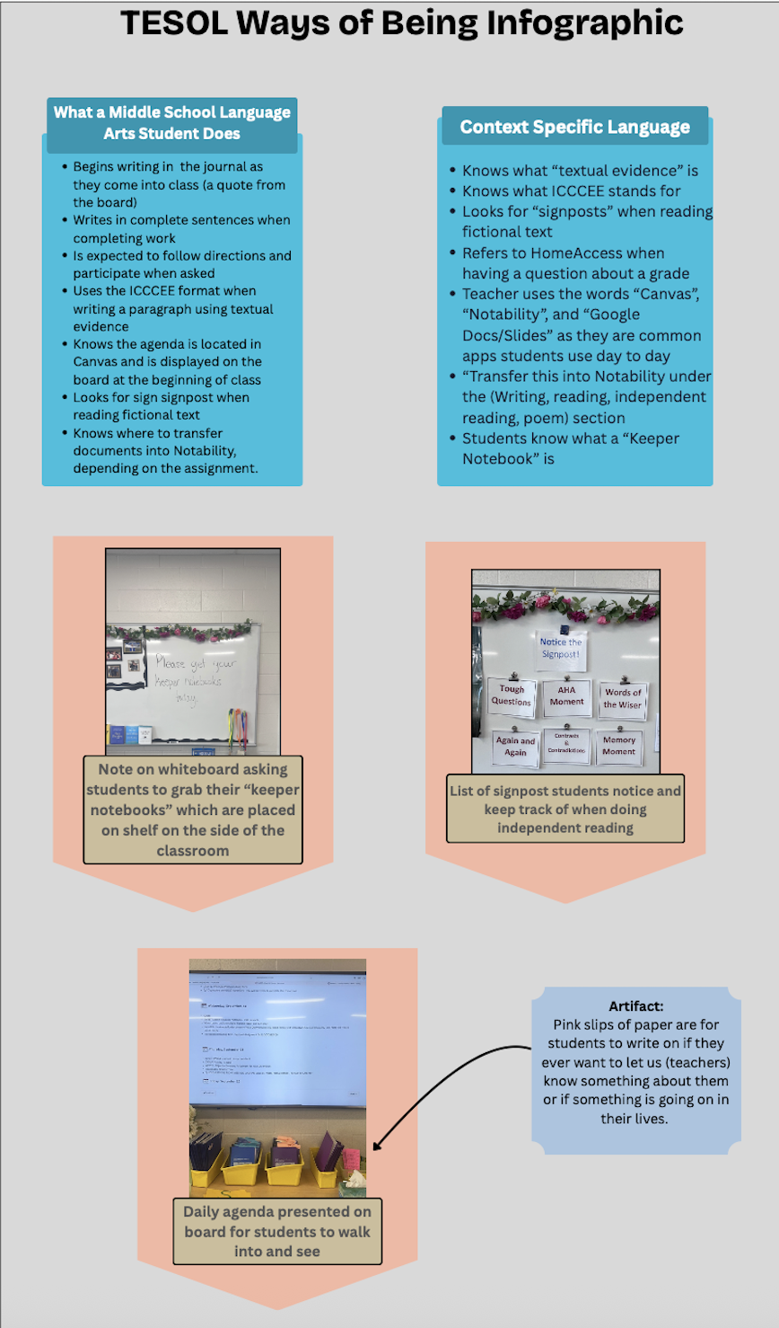
Insider’s Perspectives From ILA Pre-Service Teacher
What a Middle School Language Arts Student does:
Begins writing in the journal as they come into class (a quote from the board)
﻿﻿Writes in complete sentences when completing work
﻿﻿Is expected to follow directions and participate when asked
﻿﻿Uses the ICCCEE format when writing a paragraph using textual evidence
﻿﻿Knows the agenda is located in Canvas and is displayed on the board at the beginning of class
﻿﻿Looks for sign signpost when reading fictional text
﻿﻿Knows where to transfer documents into Notability, depending on the assignment.
Context Specific Language:
Knows what "textual evidence" is
﻿﻿Knows what ICCCEE stands for
﻿﻿Looks for "signposts" when reading fictional text
﻿﻿Refers to HomeAccess when having a question about a grade
﻿﻿Teacher uses the words "Canvas", "Notability", and "Google Docs/Slides" as they are common apps students use day to day
﻿﻿"Transfer this into Notability under the (Writing, reading, independent reading, poem) section
﻿﻿Students know what a "Keeper Notebook" is

Slide 12
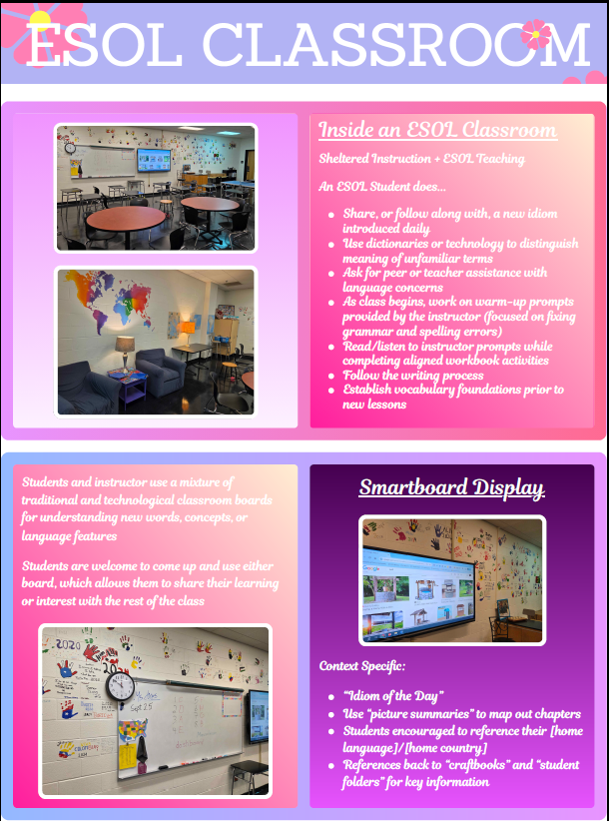
Insider’s Perspectives From TESOL Pre-Service Teacher
What an EL does...
Students and instructor use a mixture of traditional and technological classroom boards for understanding new words, concepts, or language features
Students are welcome to come up and use either board, which allows them to share their learning or interest with the rest of the class
Context-specific language...
vocabulary foundations
words, concepts, language features
idiom of the day
picture summaries
home languages
read, write, listen

Slide 13
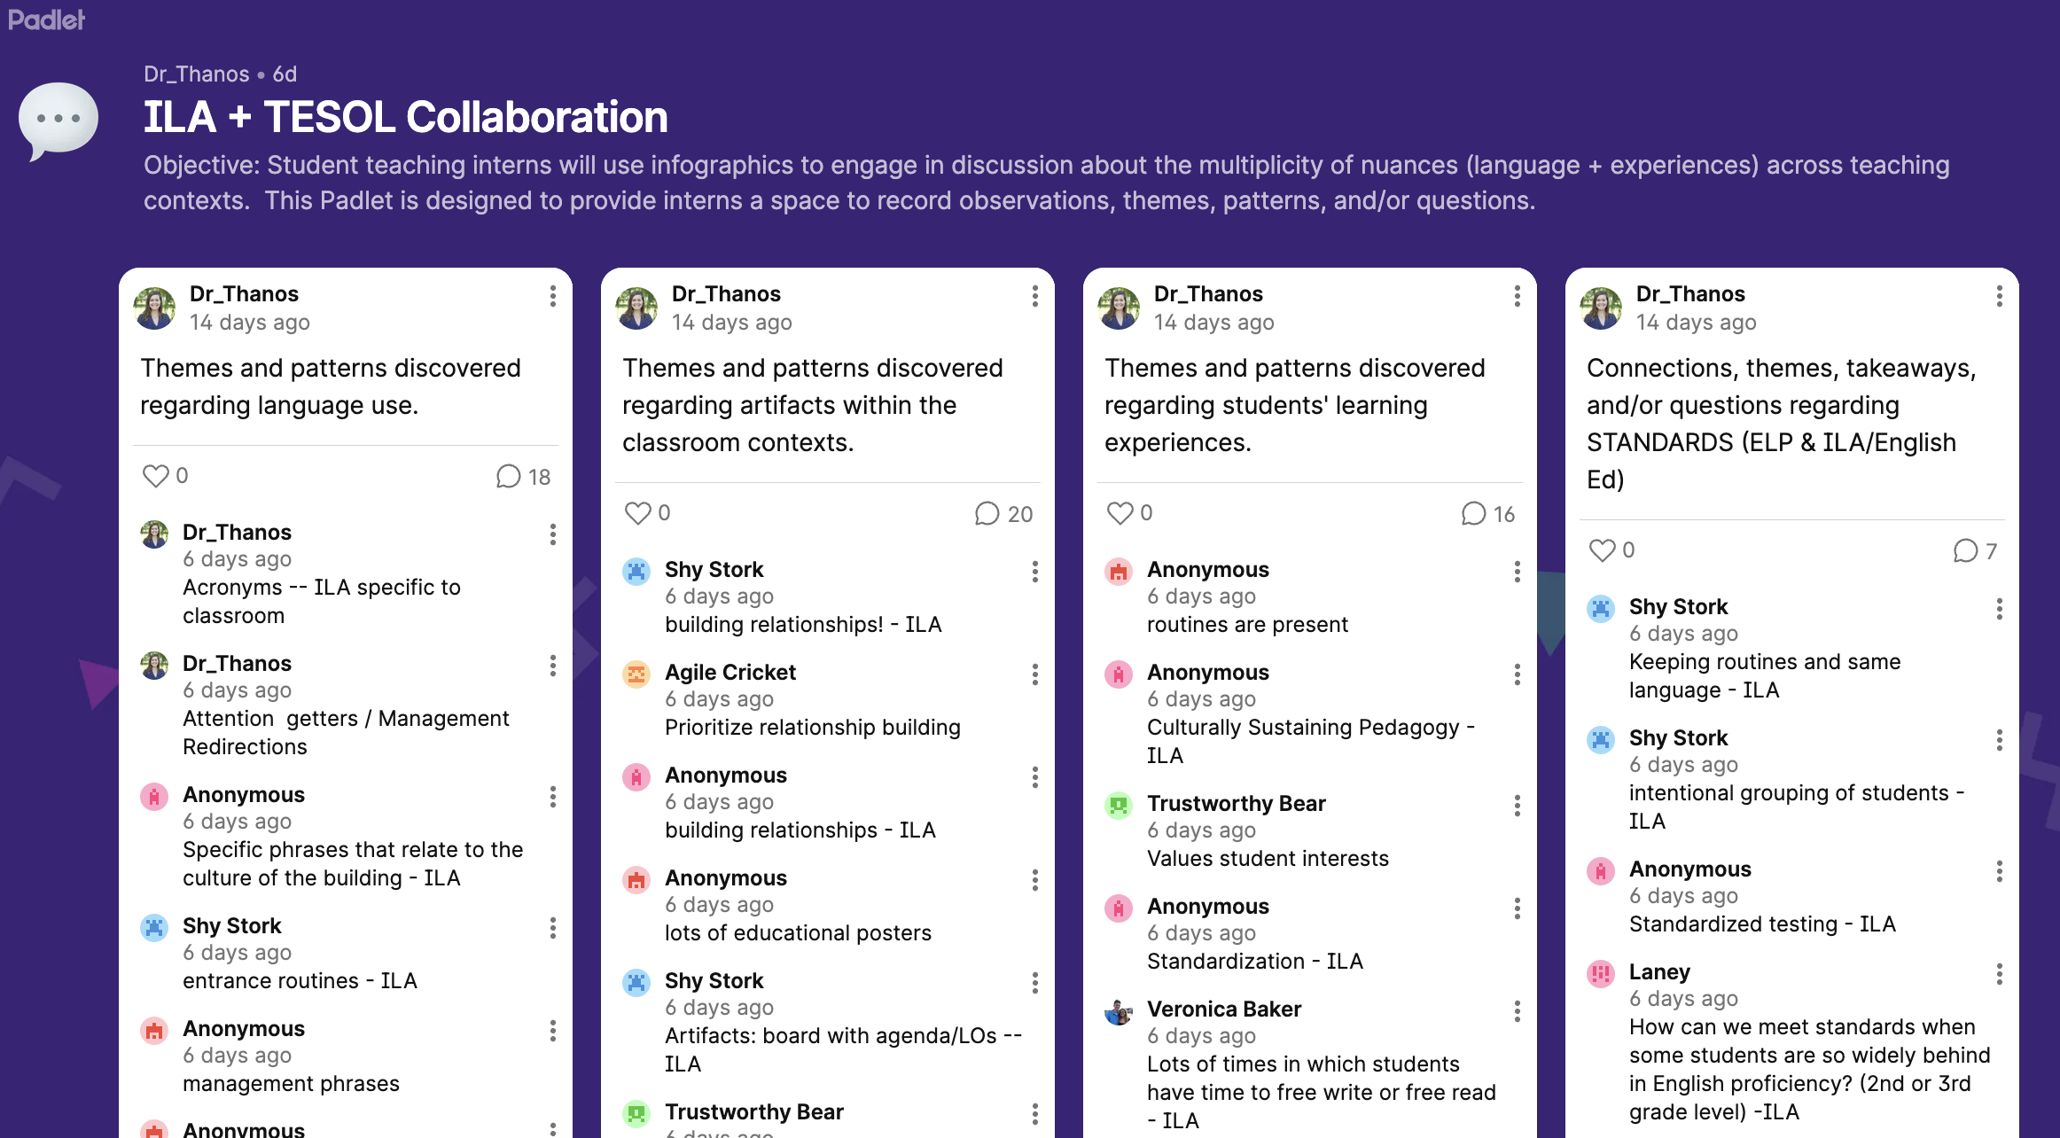
TESOL & ILA Pre-Service Teacher's Engagement

Slide 14
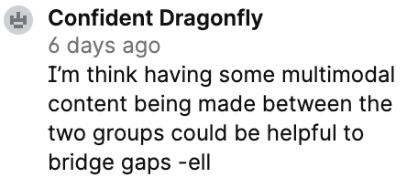
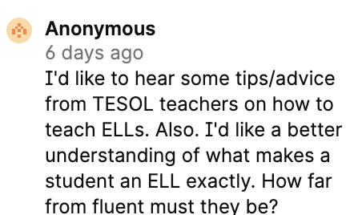
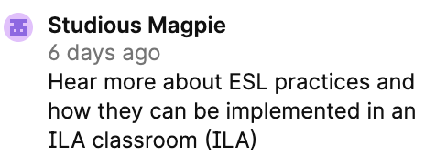
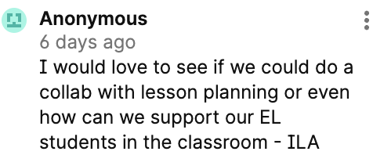
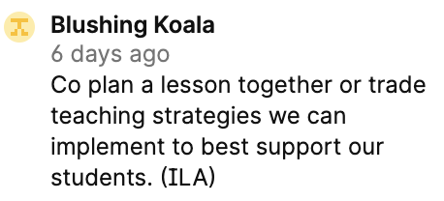
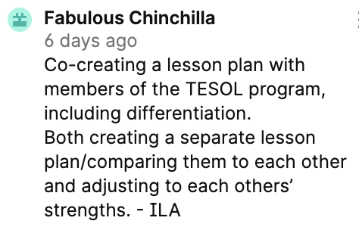
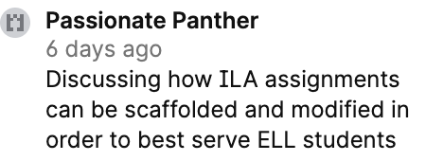
Looking Ahead – Next Steps for collaboration based on our students' reflections
Standards and Lesson Planning
Scaffolding Assignments
Understanding ELs and Pointing Out Assumptions (we don't know what we don't know)

Slide 15
Expanding the Collaborative Dialogue
How are you and your pre-service teachers talking about teaching EL students?

